Slide 1
Regression and Classification with sklearn Python Examples

Slide 2
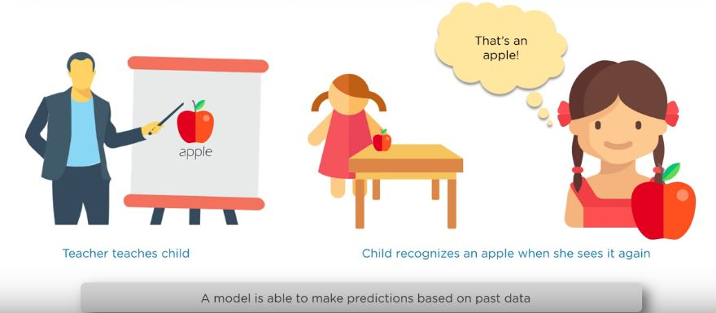
What is supervised learning ?

Slide 3
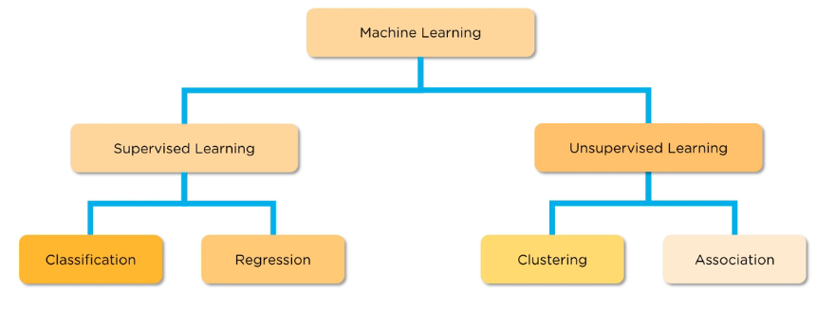
Where does regression fits in ?

Slide 4
Classification and regression
Classification : Based on discrete values
Example :
1)Binary classification (0/1) / will the customer buy the product ?
2) Class Classification : whether image is cat/dog …
Regression : predict a value (continues value)
Example : Predict a Temperature

Slide 5

Logistic Regression
Algorithm used in Classification not regression !
For regression we use Linear Regression Algorithm .. That makes sense ☺

Slide 6
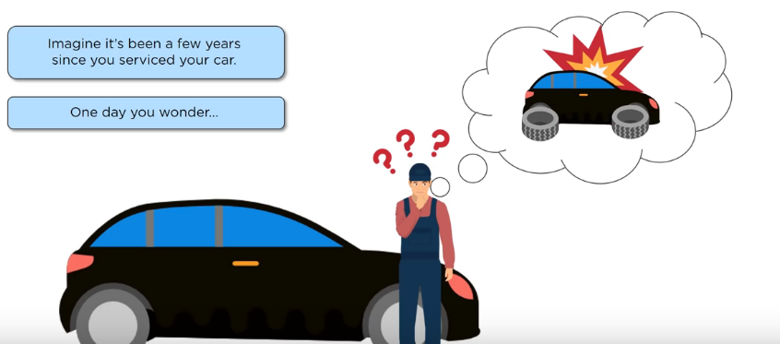
What is logistic regression ?

Slide 7
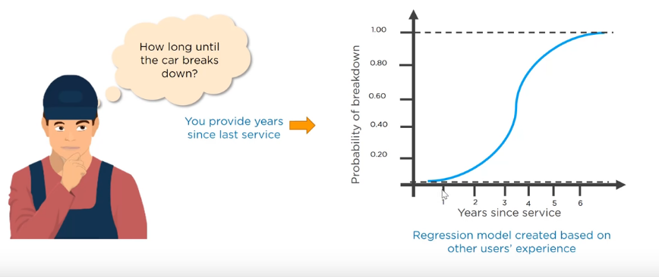
What is logistic regression ?

Slide 8
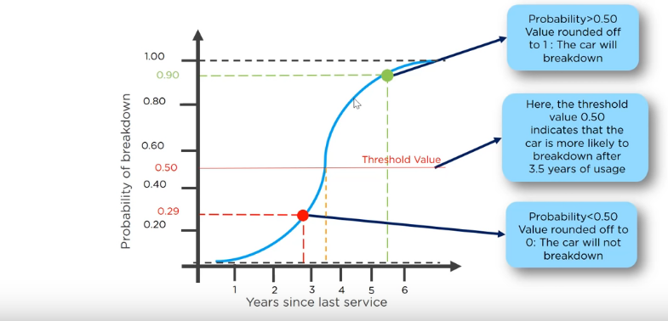
How logistic regression work ?

Slide 9
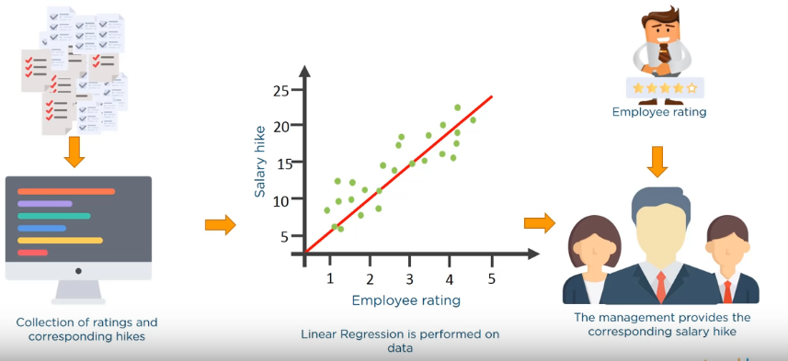
Linear Regression Example
Determining continuous value like salary for a new Employee

Slide 10
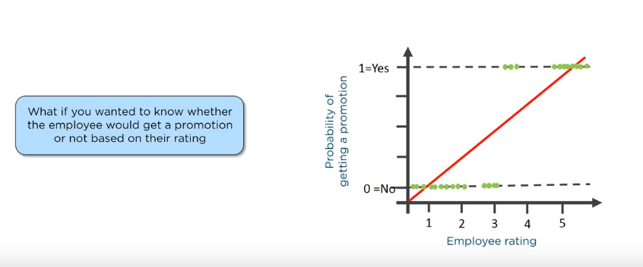
Logistic Regression Example

Slide 11
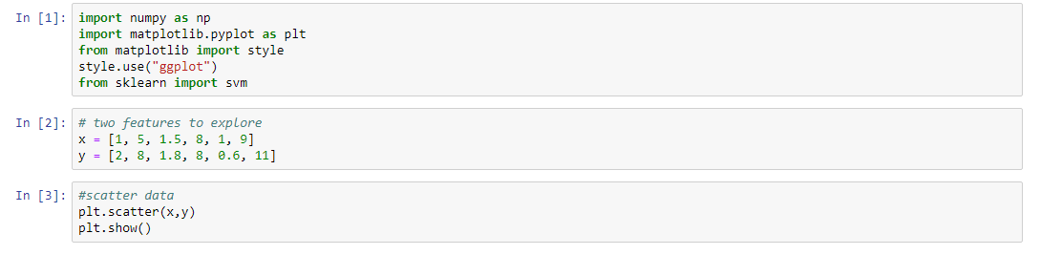
Using sklearn in svm linear example

Slide 12
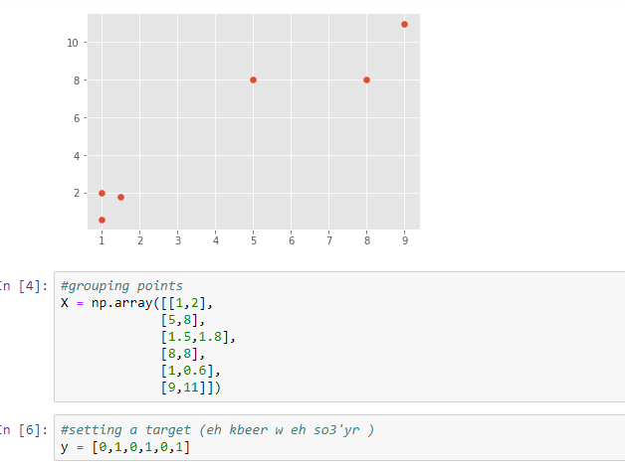
Using sklearn in svm linear example

Slide 13
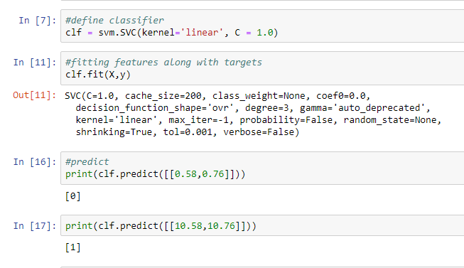
Using sklearn in svm linear example

Slide 14
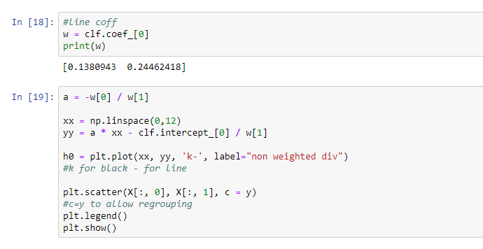
Using sklearn in svm linear example

Slide 15
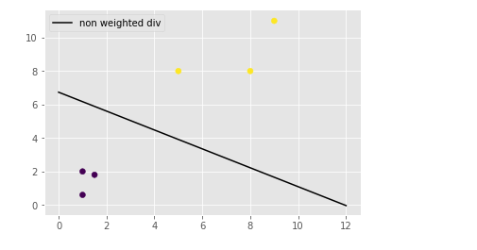
Using sklearn in svm linear example

Slide 16
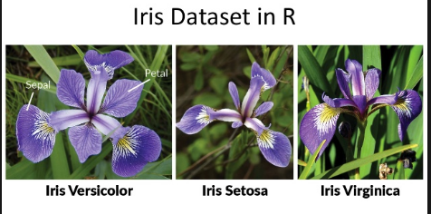
The Iris Dataset

Slide 17
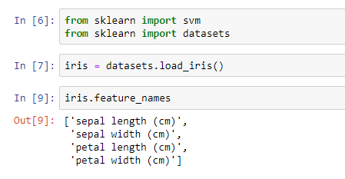
The Iris Dataset

Slide 18
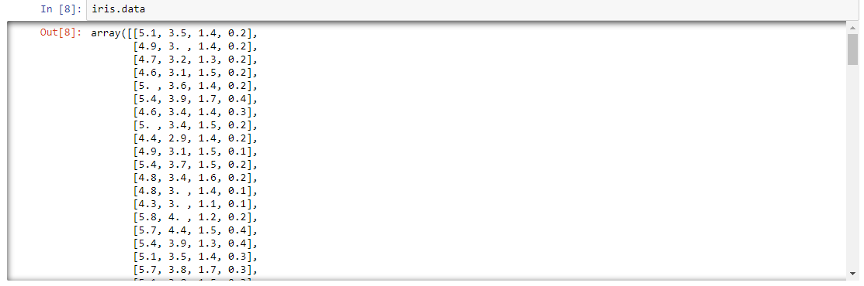
The Iris Dataset

Slide 19
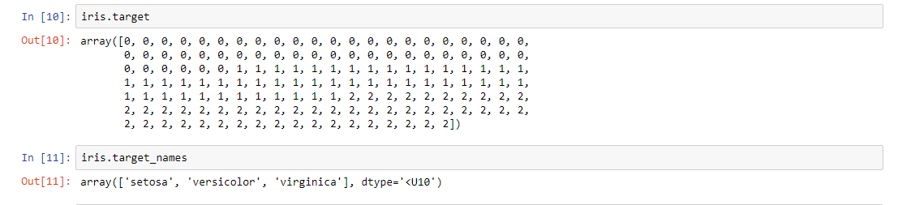
The Iris Dataset

Slide 20
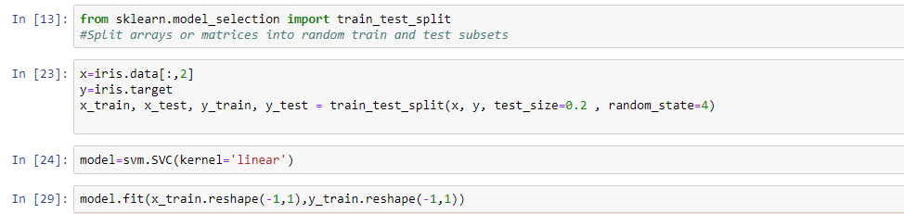
The Iris Dataset

Slide 21
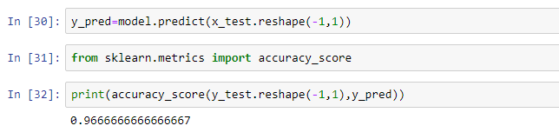
The Iris Dataset

Slide 22
Thanks ☺

